Slide 1
Chapter 5_ Lect3
Basic Computer Organization

Slide 2
5-8 Complete Computer Description
  The final flowchart of the instruction cycle : Fig. 5-15
  The control function and microoperation : Tab. 5-6

Slide 3
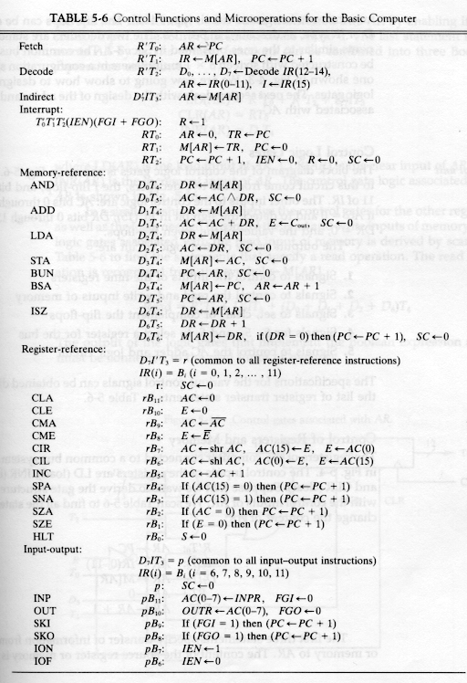
Mano's Computer: RTL

Slide 4
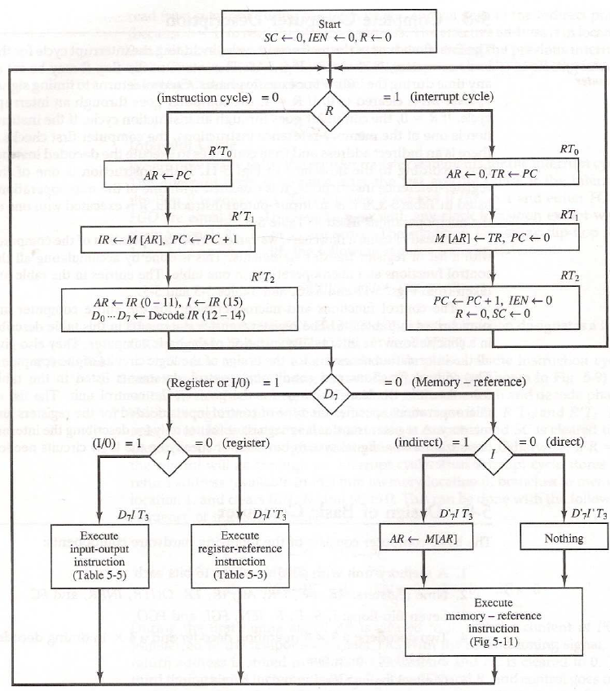

Slide 5
5-9 Design of Basic Computer
  The basic computer consists of the following hardware components
    A memory unit with 4096 words of 16bits
    Nine registers : AR, PC, DR, AC, IR, TR, OUTR, INPR, and SC
    Seven F/Fs : I, S, E, R, IEN, FGI, and FGO
    Two decoder in control unit : 3 x 8 operation decoder, 4 x 16 timing decoder.
    A 16-bit common bus.
    Control Logic Gates.
    Adder and Logic circuit connected to the AC input

Slide 6
Control Logic Gates
  Control Logic Gates
    Signals to control the inputs of the nine registers
    Signals to control the read and write inputs of memory
    Signals to set, clear, or complement the F/Fs
    Signals for S₂ S₁ S₀ to select a register for the bus
    Signals to control the AC adder and logic circuit

Slide 7

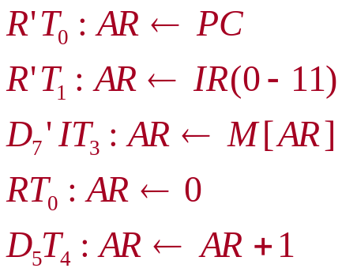
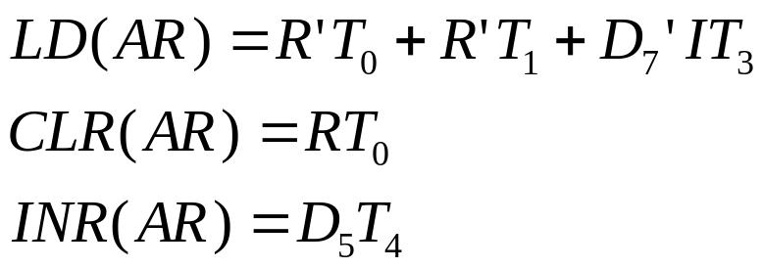
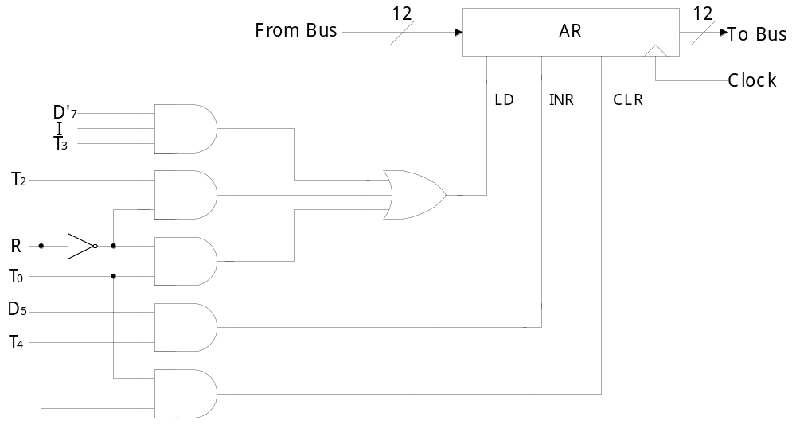
  Register Control : AR
    Control inputs of AR : LD, INR, CLR
    Find all the statements that change the AR
    in Tab. 5-6
    Control functions

Slide 8


  Memory Control : READ
    Control inputs of Memory : READ, WRITE
    Find all the statements that specify a read operation in Tab. 5-6
    Control function

Slide 9
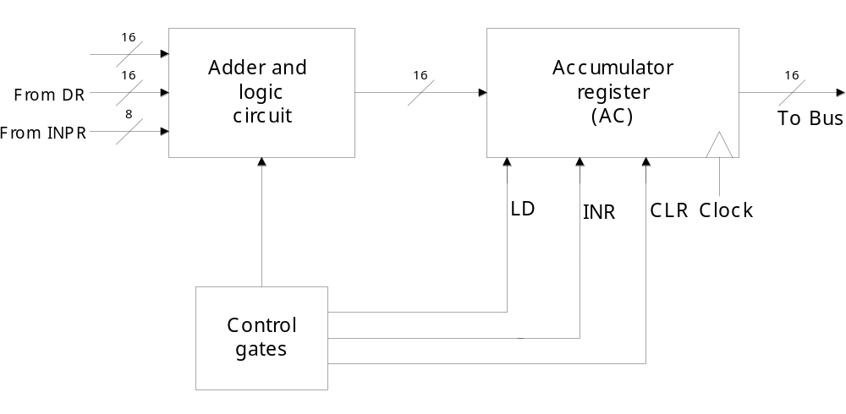
5-10 Design of Accumulator Logic
  Circuits associated with AC : Fig. 5-19
Fig. 5-21
Fig. 2-11
Fig. 5-20

Slide 10

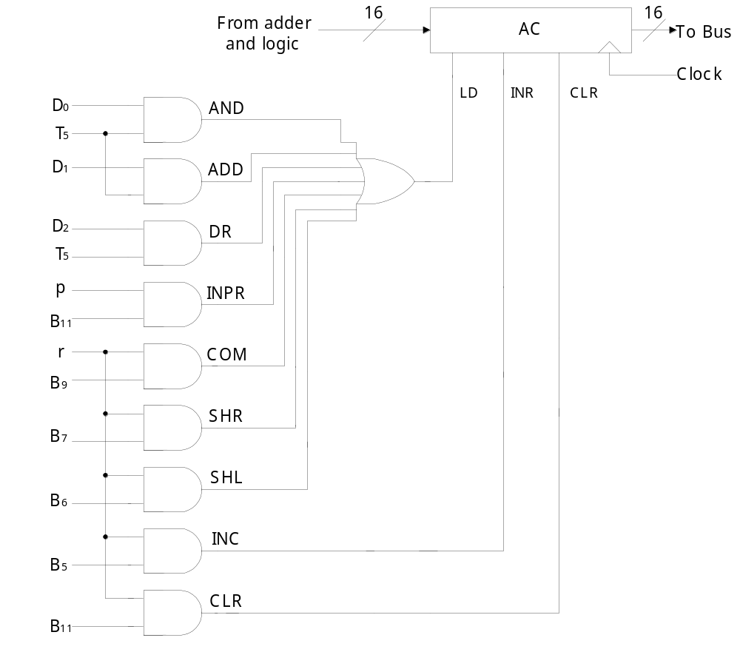
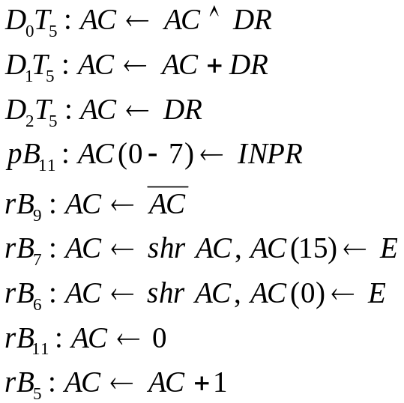
  Control of AC : Fig. 5-20
    Find the statement that change the AC :
LD
CLR
INR

